Slide 1
Unit Five: Resources
Week One: “The View From Saturday”
Selection Vocabulary Words

Slide 2
accustomed (adjective)
used to

Slide 3
decline (verb)
to lose strength, to worsen; to politely refuse

Slide 4
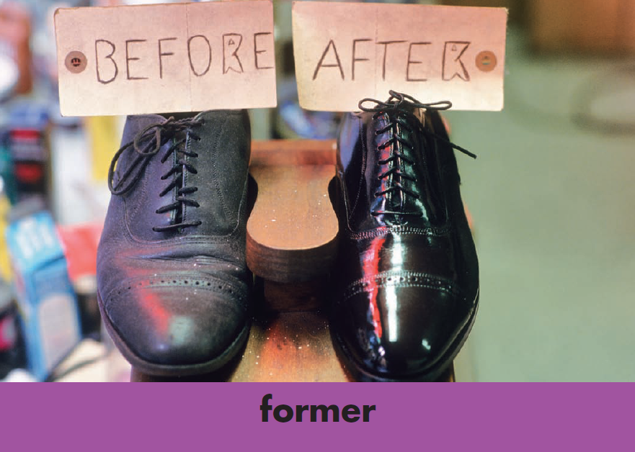
former (adjective)
earlier; past

Slide 5
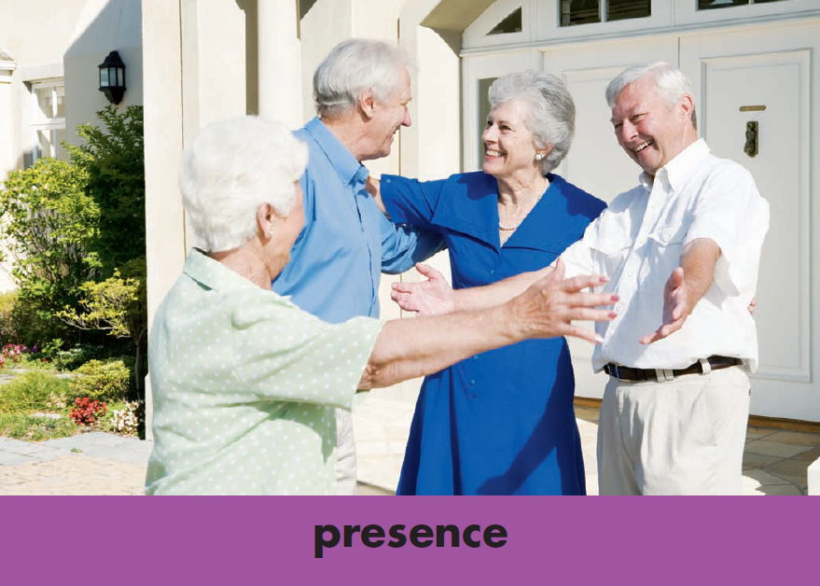
presence (noun)
condition of being in the current place or time

Slide 6
unaccompanied (adjective)
not with another person; alone

